Slide 1
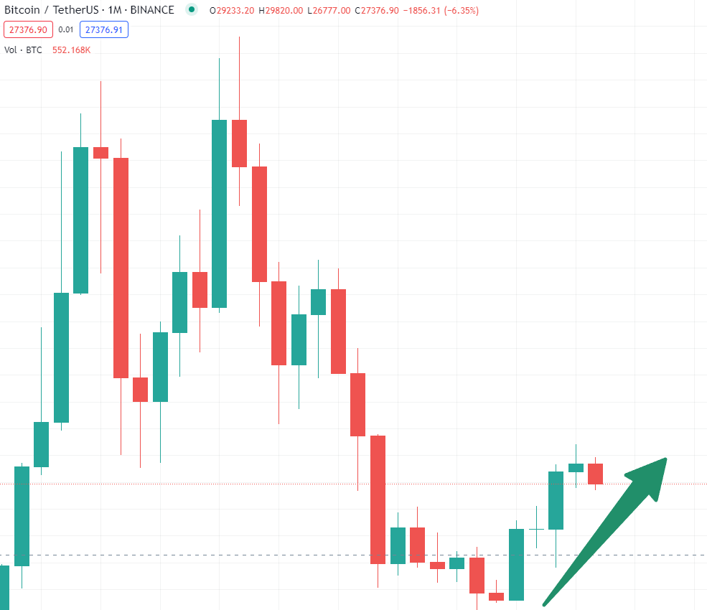
CANDLESTICK INFORMATICS

Slide 2

Introduction
Market Sentiments
Market Strength and Weakness
Tools:
CandleStick Types and Patterns
Indicators
Oscillators
Notes:
“Technical Analysis is method to map the market sentiment, market’s strength and market weakness.”

Slide 3

CandleSticks
Understanding Psychology of
Exchanging, Control Emotions
Origin:
Japanese Rice Farmer Munehisa Homma
Introduced to US by Steve Nison in his book “Japanese Candlestick Charting Techniques (1991)”
Interconnection between price and the supply and demand
Notes:
Candlesticks
· They teach us about trading psychology and emotional discipline.
· It was used by Japanese rice farmers.
· Steve Nison introduced in US stock exchange.
· Four key parameters in a candle stick
· Open, Close, High, Low
· It also indicates bullish (green) or bearish (orange/red) trend of the market.
Vital tool to comprehend trading psychology and emotional control
Historical Origin:
Originated with Japanese rice farmers, centuries ago
Introduced to the US stock exchange by Steve Nison
Key Elements of a Candlestick:
Open: Opening price of the trading period
Close: Closing price of the trading period
High: Highest price reached during the period
Low: Lowest price reached during the period
Market Trend Indicators:
Candlestick color:
Bullish (Green): Price closed higher than it opened
Bearish (Orange/Red): Price closed lower than it opened
Trading Insights:
Psychological Insights: Reflects market sentiment and trader emotions
Trading Signals: Patterns offer clues on potential price movements
Benefits of Candlestick Analysis:
Visual Interpretation: Simplifies complex market data
Trend Identification: Aids in recognizing bullish and bearish trends
Limitations and Considerations:
Context Matters: Combine candlestick analysis with other tools
Historical Data: Previous patterns don't guarantee future outcomes
Conclusion:
Candlestick charts offer insights into market psychology and trends
Integral part of technical analysis for traders and investors

Slide 4
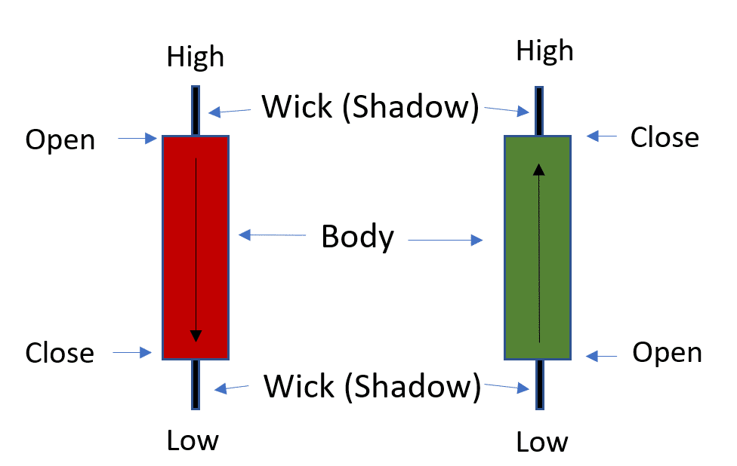
CandleSticks
Parts:
Body (Wide Part)
Wick (Hangs above/below the body)
Elements:
Open, Close, High, Low
Market Trend Indicators
Green (Bullish)
Orange/Red (Bearish)

Slide 5
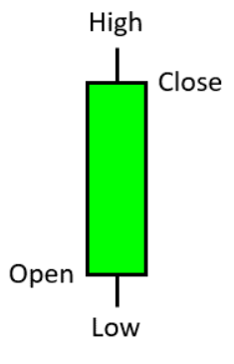
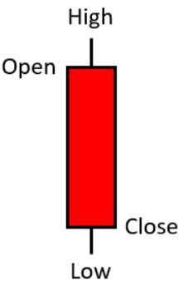
Neutral CandleStick Patterns
Marubozu:
Condition: Long body, minimal or no wicks/shadows.
Meaning: Strong buying/selling momentum.
Significance: Indicates clear market direction.

Slide 6
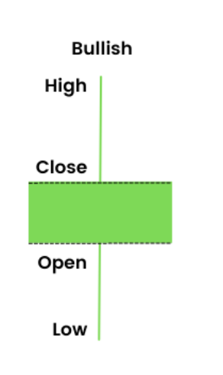
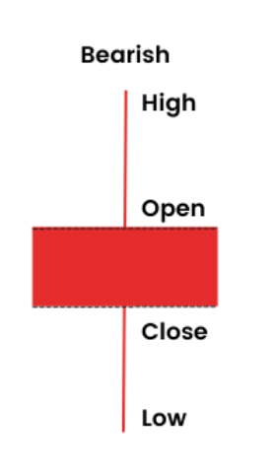
Neutral CandleStick Patterns
Spinning Top:
Condition: Small body, long upper and lower wicks.
Meaning: Market indecision, potential reversal.
Significance: Suggests a potential change in trend or momentum.

Slide 7
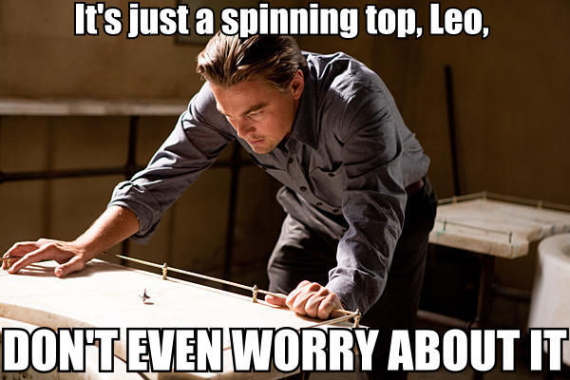

Slide 8
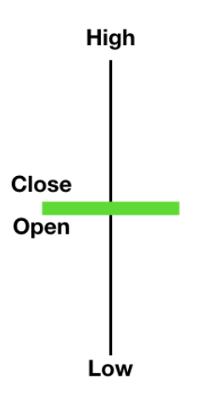
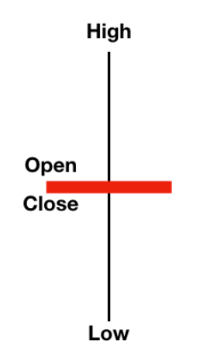
Neutral CandleStick Patterns
Symmetrical Doji:
Condition: Open and close prices nearly equal, forming a cross shape.
Meaning: Market uncertainty, balanced forces.
Significance: Implies potential trend reversal or continuation, depending on context.
Notes:
Characteristics of Symmetrical Doji:
Upper and Lower Wick: Both wicks are equal, forming a cross shape
No Body: Open and close prices are virtually identical
Trend Reversal: Indicates potential trend reversal
Interpreting Symmetrical Doji Patterns:
Market Indecision: Suggests equilibrium between buyers and sellers
Transition Signal: Implies a shift from current trend to a potential reversal
Symmetrical Doji as a Reversal Signal:
Confirmation Required: Requires additional price action to validate reversal
Combined Analysis: Consider the context of surrounding candlesticks
Considerations and Limitations:
Confirmation Needed: Rely on confirmation from subsequent candles
Combine with Context: Integrate symmetrical doji analysis with broader trend assessment
Practical Application:
Warning Signal: Symmetrical doji alerts traders to potential trend shifts
Cautionary Indicator: Useful for determining entry and exit points
Conclusion:
Symmetrical doji candlestick patterns highlight market indecision and potential trend reversals
Characteristics of Dragonfly Doji:
No Body, Only Lower Wick: Absence of a body, emphasis on the lower wick
Price Dropping, Bulls Push Up: Indicates price decline followed by bullish rebound
Bullish Dominance: Suggests potential bullish reversal
Interpreting Dragonfly Doji Patterns:
Bulls Regain Control: Bulls drive price upward after a bearish dip
Market Sentiment Shift: Implies a possible shift from bearish to bullish sentiment
Dragonfly Doji as a Reversal Signal:
Confirmation Required: Subsequent price action validates bullish reversal
Combine with Context: Assess the pattern within the broader trend
Considerations and Limitations:
Confirmation Needed: Rely on confirmation from follow-up candles
Contextual Analysis: Integrate dragonfly doji with overall trend assessment
Practical Application:
Bullish Signal: Dragonfly doji acts as an early indicator of potential bullish reversal
Entry Point Identification: Helps in identifying optimal entry levels
Conclusion:
Dragonfly doji candlestick patterns highlight bullish sentiment after a price drop

Slide 9
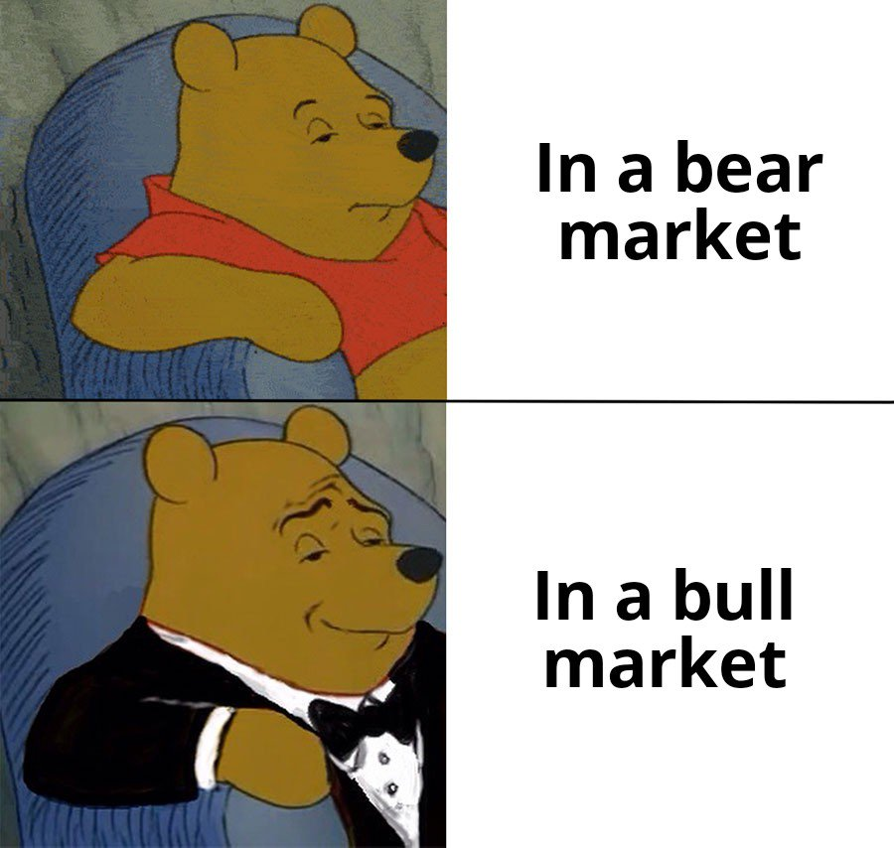

Slide 10
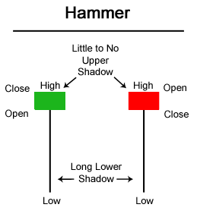
Bullish Reversal CandleStick Patterns
Hammer:
Condition: Small body, long lower wick, little to no upper wick.
Meaning: Reversal signal after downtrend.
Significance: Suggests potential bullish reversal, buyers overcoming sellers.

Slide 11
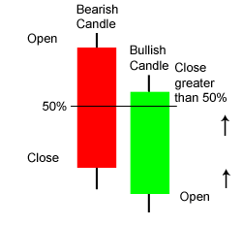
Bullish Reversal CandleStick Patterns
Piercing Pattern:
Condition: Two candlesticks, second opens below first's low and closes above first's midpoint
Meaning: Bullish reversal after downtrend
Significance: Indicates potential trend shift, buying interest increasing

Slide 12
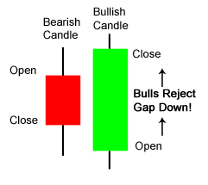
Bullish Reversal CandleStick Patterns
Bullish Engulfing:
Condition: Second candle covers the first, opens lower and closes higher.
Meaning: Positive reversal potential.
Significance: Indicates shift in sentiment, price momentum likely changing.

Slide 13


Slide 14
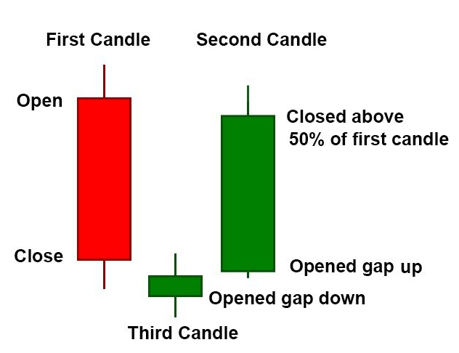
Bullish Reversal CandleStick Patterns
Morning Star:
Condition: Series of three candles - downtrend, small candle, uptrend
Meaning: Positive reversal signal
Significance: Implies potential trend shift, optimism growing

Slide 15
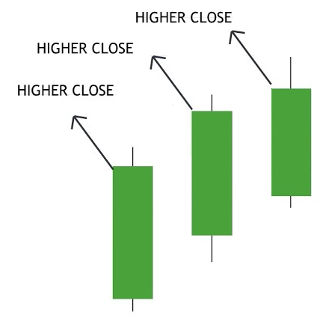
Bullish Reversal CandleStick Patterns
Three White Soldiers:
Condition: Three consecutive rising candles.
Meaning: Strong upward sentiment.
Significance: Suggests continued bullish momentum.

Slide 16
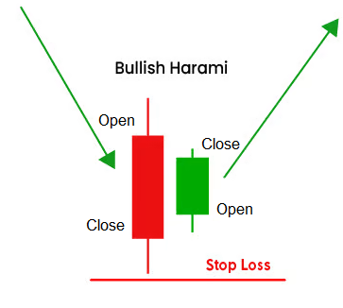
Bullish Reversal CandleStick Patterns
Bullish Harami:
Condition: Small candle within previous, closes higher.
Meaning: Potential uptrend reversal.
Significance: Suggests possible positive change in direction.

Slide 17
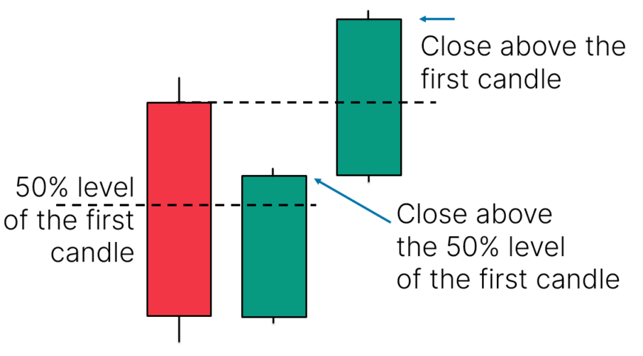
Bullish Reversal CandleStick Patterns
Three Inside Up:
Condition: Small candle's range within previous, closes above prior high.
Meaning: Potential trend reversal to the upside.
Significance: Indicates sentiment shift, possible bullish momentum.

Slide 18


Slide 19
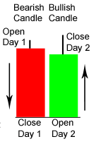
Bullish Reversal CandleStick Patterns
Tweezer Bottom:
Condition: Two or more candles with matching lows.
Meaning: Possible reversal signal.
Significance: Suggests potential shift from bearish to bullish sentiment.

Slide 20
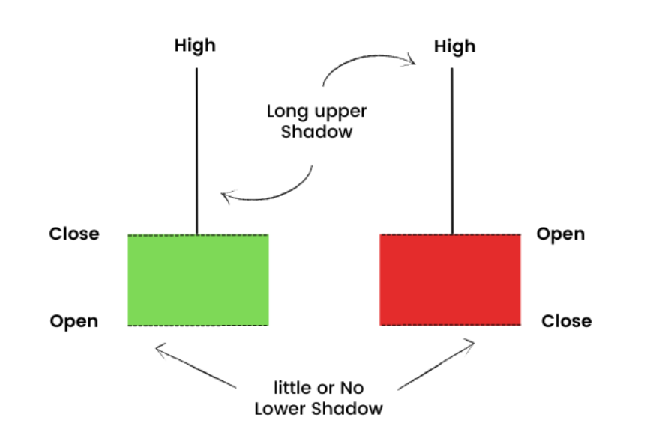
Bullish Reversal CandleStick Patterns
Inverted Hammer:
Condition: Small body, long upper shadow.
Meaning: Potential trend reversal.
Significance: Suggests possible shift in sentiment, bullish momentum rising.

Slide 21
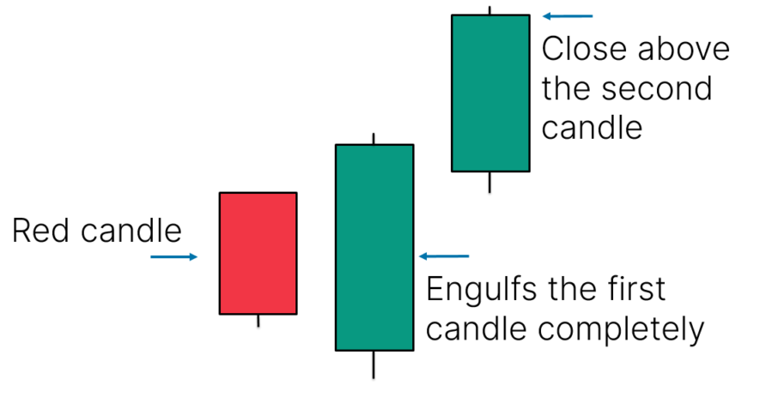
Bullish Reversal CandleStick Patterns
Three Outside Up:
Condition: Larger bullish candle engulfs prior bearish candle.
Meaning: Potential reversal to the upside.
Significance: Implies changing sentiment, potential bullish momentum.

Slide 22
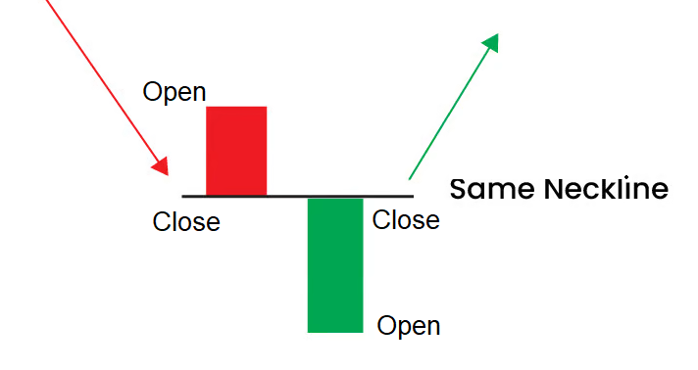
Bullish Reversal CandleStick Patterns
On-Neck Pattern:
Condition: Downtrend followed by small bullish candle's close near prior day's low.
Meaning: Potential bullish trend reversal.
Significance: Suggests possible shift from bearish to bullish sentiment.

Slide 23


Slide 24
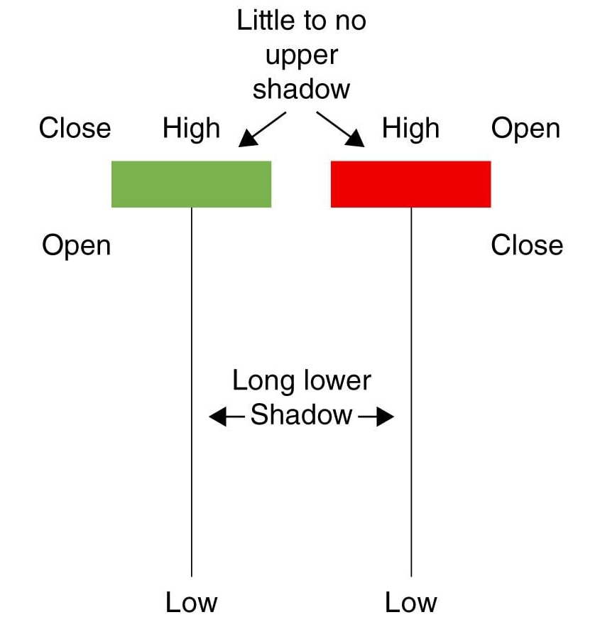
Bearish Reversal CandleStick Patterns
Hanging Man:
Condition: Small body, long lower shadow.
Meaning: Potential trend reversal.
Significance: Suggests possible shift in sentiment, bearish momentum rising.

Slide 25
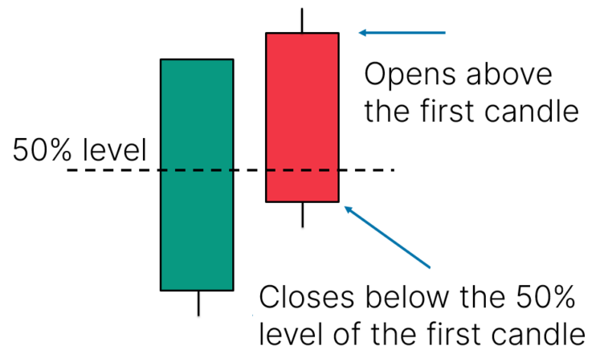
Bearish Reversal CandleStick Patterns
Dark Cloud Cover:
Condition: Uptrend followed by bearish candle closing below prior day's midpoint.
Meaning: Potential bearish reversal.
Significance: Suggests possible shift from bullish to bearish sentiment.

Slide 26
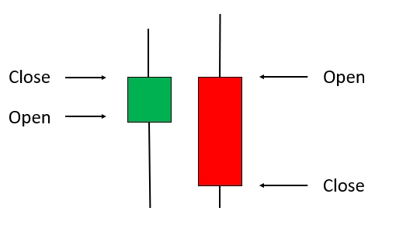
Bearish Reversal CandleStick Patterns
Bearish Engulfing:
Condition: Second candle fully covers first, opens higher and closes lower.
Meaning: Strong downside reversal signal.
Significance: Implies potential trend shift, pessimism increasing.

Slide 27
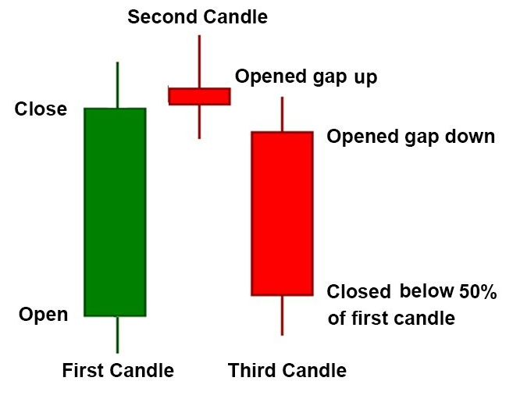
Bearish Reversal CandleStick Patterns
Evening Star:
Condition: Series of three candles - uptrend, small candle, downtrend.
Meaning: Potential downward reversal.
Significance: Suggests sentiment changing, possible bearish shift.

Slide 28
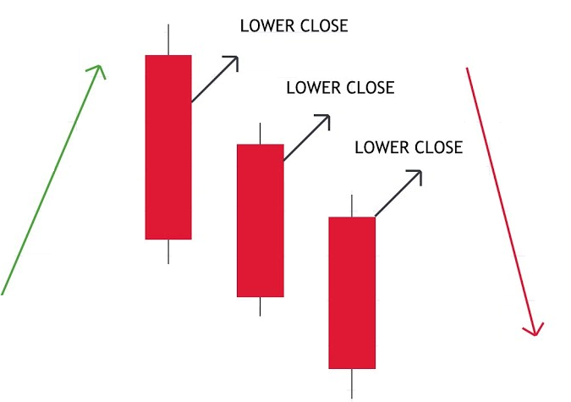
Bearish Reversal CandleStick Patterns
Three Black Crows:
Condition: Three consecutive declining candles.
Meaning: Strong downward sentiment.
Significance: Implies continued bearish momentum.

Slide 29
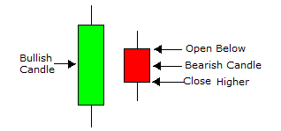
Bearish Reversal CandleStick Patterns
Bearish Harami:
Condition: Small candle within previous, closes lower.
Meaning: Potential downtrend reversal
Significance: Suggests possible shift in direction, bearish momentum increasing.

Slide 30
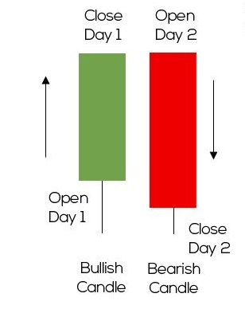
Bearish Reversal CandleStick Patterns
Tweezer Top:
Condition: Two or more candles with matching highs.
Meaning: Potential reversal signal.
Significance: Suggests possible shift in direction, bearish momentum growing.

Slide 31
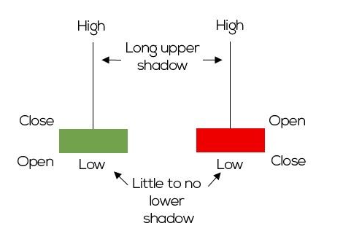
Bearish Reversal CandleStick Patterns
Shooting Star:
Condition: Small body, long upper shadow.
Meaning: Possible trend reversal.
Significance: Suggests potential shift in sentiment, bearish pressure increasing.

Slide 32


Slide 33
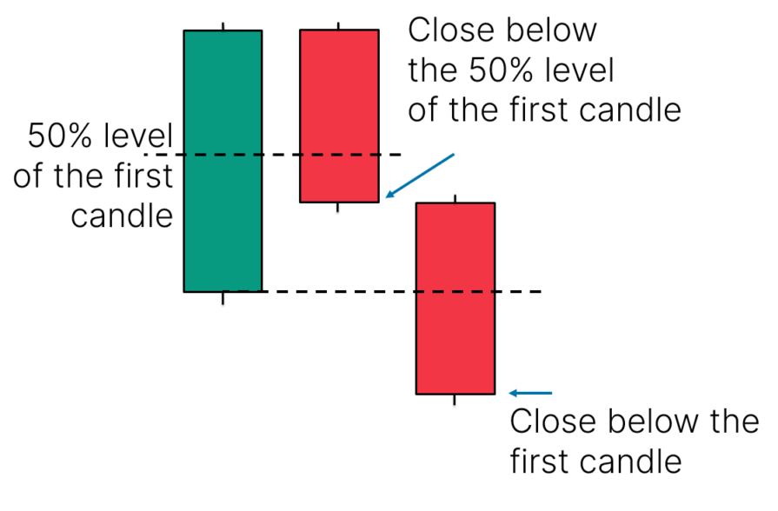
Bearish Reversal CandleStick Patterns
Three Inside Down:
Condition: Small candle's range within previous, loses below prior low.
Meaning: Potential trend reversal to the downside.
Significance: Suggests sentiment shift, possible bearish momentum rising.

Slide 34
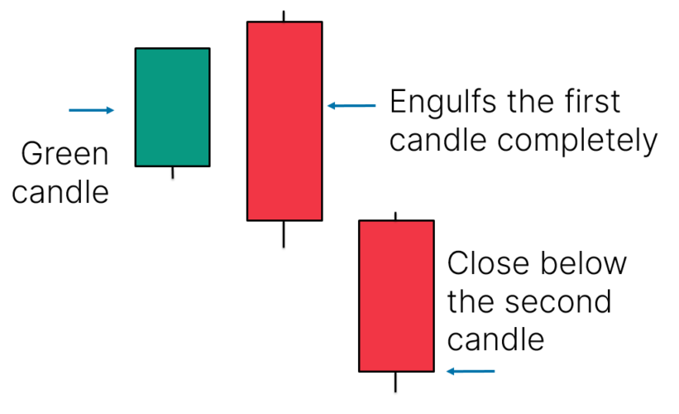
Bearish Reversal CandleStick Patterns
Three Outside Down:
Condition: Larger bearish candle engulfs prior bullish candle.
Meaning: Potential reversal to the downside.
Significance: Implies changing sentiment, possible bearish momentum.

Slide 35
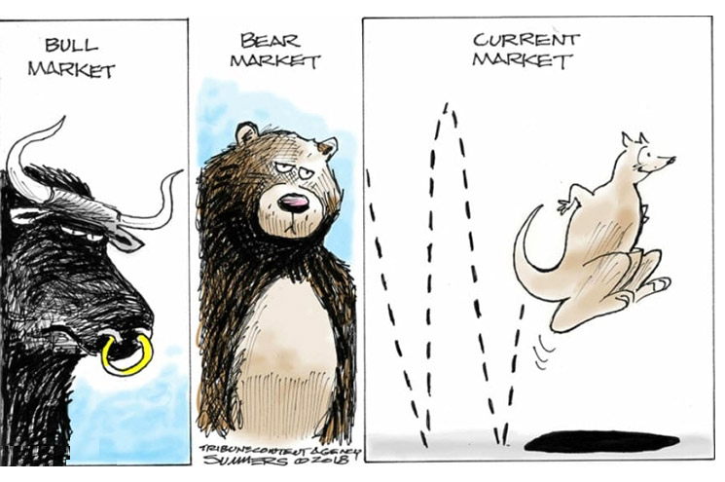

Slide 36
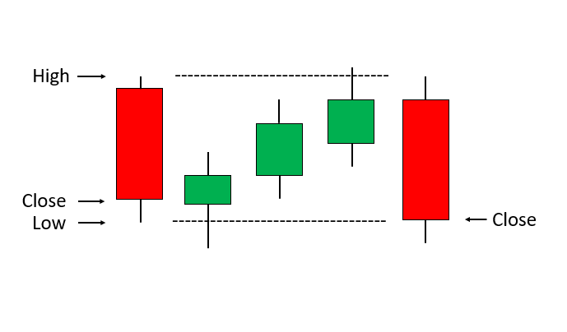
Continuation CandleStick Patterns
Falling Three Methods:
Condition: Downtrend followed by a small bullish candle surrounded by falling candles.
Meaning: Potential continuation of downtrend.
Significance: Suggests ongoing bearish momentum, possible further decline.

Slide 37
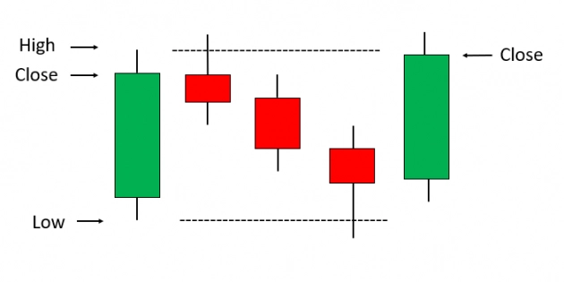
Continuation CandleStick Patterns
Rising Three Methods:
Condition: Uptrend followed by a small bearish candle surrounded by rising candles.
Meaning: Potential continuation of uptrend.
Significance: Suggests ongoing bullish momentum, possible further ascent.

Slide 38
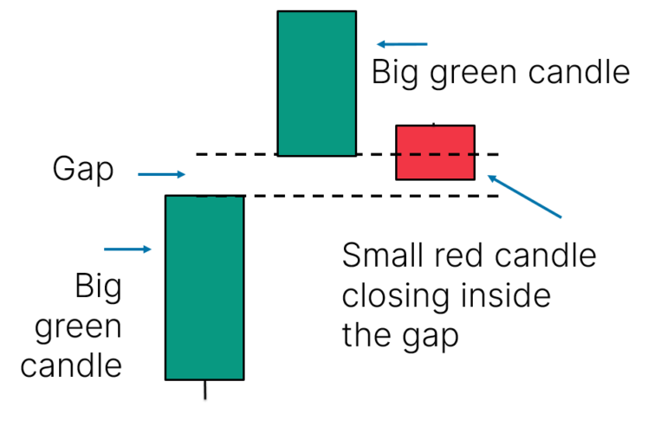
Continuation CandleStick Patterns
Upside Tasuki Gap:
Condition: Gap up with a bearish candle between two bullish candles.
Meaning: Potential continuation of uptrend.
Significance: Suggests ongoing bullish momentum, potential further rise.

Slide 39
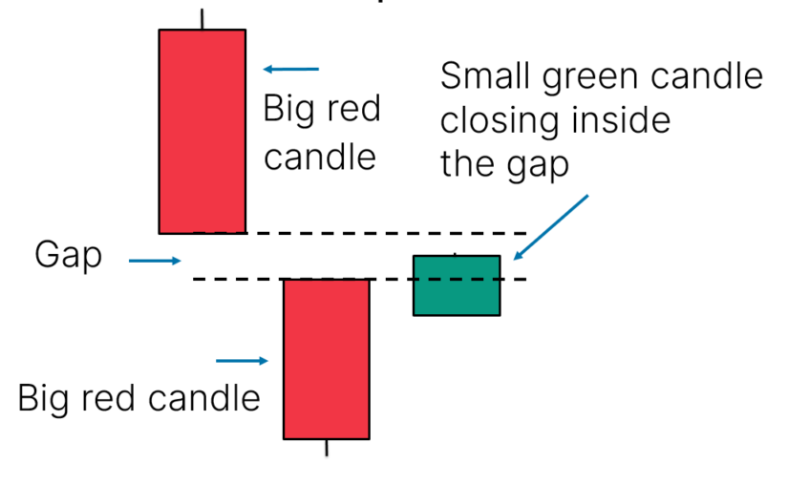
Continuation CandleStick Patterns
Downside Tasuki Gap:
Condition: Gap down with a bullish candle between two bearish candles.
Meaning: Potential continuation of downtrend.
Significance: Suggests ongoing bearish momentum, potential further decline.

Slide 40
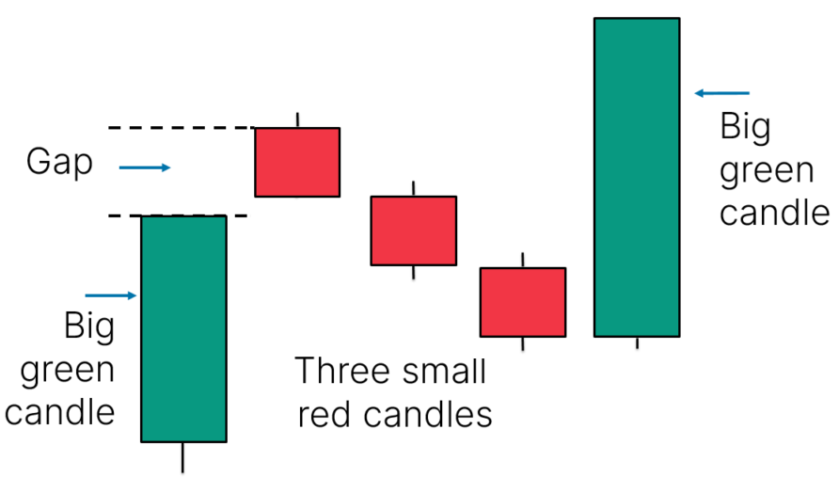
Continuation CandleStick Patterns
Mat-Hold:
Condition: Uptrend with a long bullish candle followed by a small candle, then another long bullish candle.
Meaning: Potential continuation of uptrend.
Significance: Suggests ongoing bullish momentum, possible further ascent.

Slide 41
